Slide 1
CST 2355 – Database Systems
Week 4

Slide 2
Topics Covered:
Microsoft SQL Server
Features
Security
Upsizing
ODBC and connectivity

Slide 3
Microsoft SQL Server - Introduction
https://en.wikipedia.org/wiki/Microsoft_SQL_Server
“Microsoft SQL Server is a relational database management system developed by Microsoft. As a database server, it is a software product with the primary function of storing and retrieving data as requested by other software applications—which may run either on the same computer or on another computer across a network (including the Internet). Microsoft markets at least a dozen different editions of Microsoft SQL Server, aimed at different audiences and for workloads ranging from small single-machine applications to large Internet-facing applications with many concurrent users.”
Major Features:
Built for client-server applications: secure connections over network to remote server
Has variety of adapters (e.g., ODBC (32 bit, 64 bit), JDBC, ETC.!)
Toolkits for Data warehousing, analysis, etc.
Scalability:
Large numbers of users, Petabyte-sized databases
Security:
Users, roles, encrypted connections
Concurrency:
Supports large number of concurrent users with an efficient locking strategy
Availability:
Has high-availability options for single-site installations or multi-site replication

Slide 4
Microsoft SQL Server - Features
All the usual database features: triggers, stored procedures, …
Watch the video at: What's new in SQL Server 2019 (15.x)
https://docs.microsoft.com/en-us/sql/sql-server/what-s-new-in-sql-server-ver15?view=sql-server-ver15&viewFallbackFrom=sqlallproducts-allversions
Editions and supported features of SQL Server 2019 (15.x)
https://docs.microsoft.com/en-us/sql/sql-server/editions-and-components-of-sql-server-version-15?view=sql-server-ver15&viewFallbackFrom=sql-server-2017
Demo of SQL Server Management Studio … basic features
Projects, Database, Security, Diagrams, …

Slide 5
Microsoft SQL Server - Security
Applications connect to the SQL Server as a “login”
Each database has users with “user name” associated with a login.
Typically: applicationAdminUser, applicationUser
NOT logins for each end user of the application…
Each user has individual default database
System administrators of the database have very different sets of privileges
Control privilege assignment through “roles”
Assign privileges to role, then add users to the role through “membership”

Slide 6
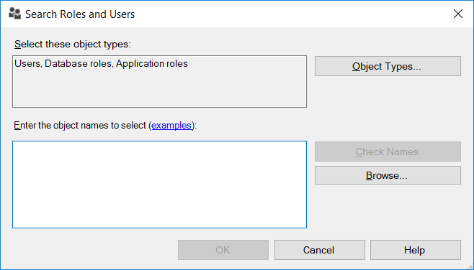
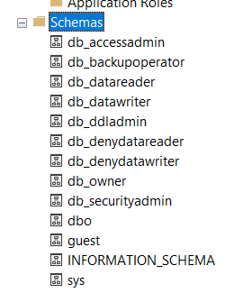
Microsoft SQL Server - Schema
Can group users by roles
Can group database objects using “Schema”
Create using SSMS under “Security” within database: owned by user, database role, or application role

Slide 7
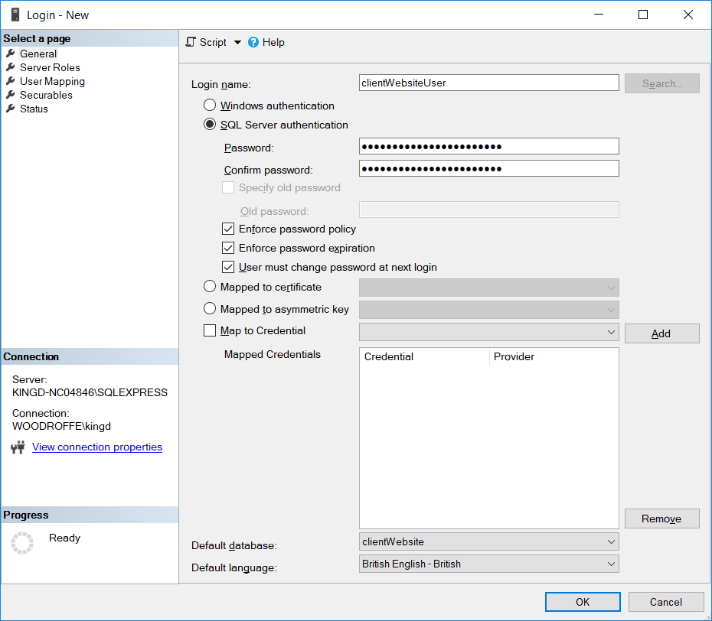
Microsoft SQL Server - Security
Creating user login:
Note:
Can use Public Key Infrastructure Certificates to have individualized data encryption on connections

Slide 8
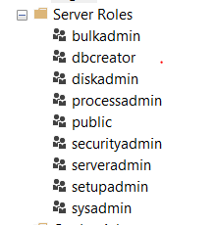
Microsoft SQL Server – Server Roles
Built-in Server Roles:

Slide 9
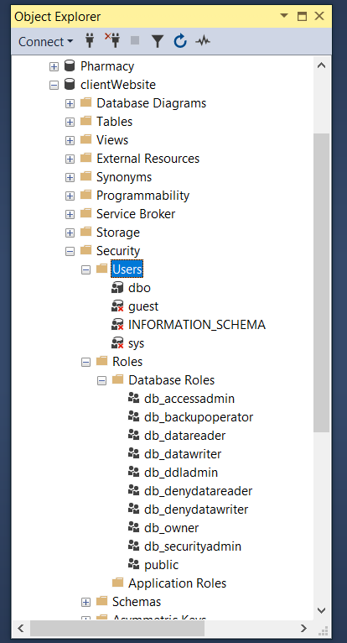
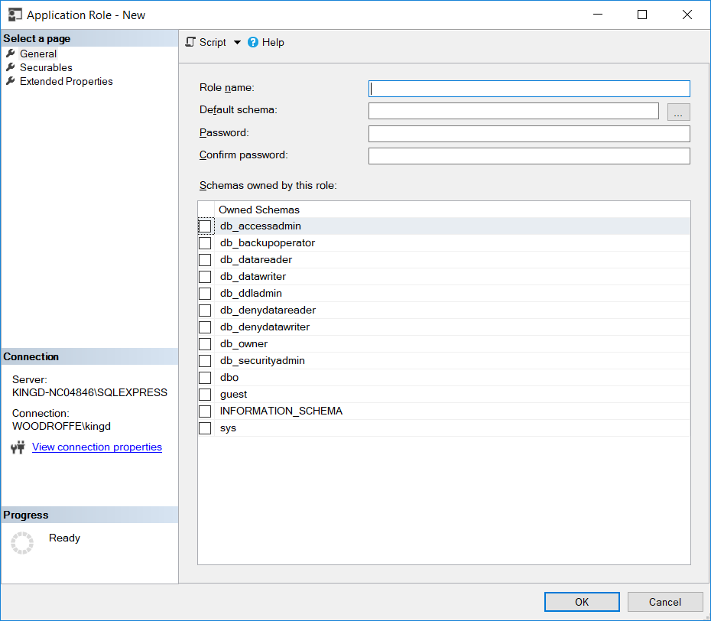
Microsoft SQL Server – Roles
Database Roles:
Application Roles:

Slide 10
Microsoft Access – Upsizing
Can import data directly using the Data Import Wizard in Microsoft SQL Server (Excel, Access, ODBC sources, SQL Native, …)
Either import from 32 bit data sources using the built-in Wizard,
Or, use the 64 bit version of the importation wizard in Windows
“SQL Server 2019 Import and Export Data (64bit)”
If you are moving from Microsoft Access and want to get all the foreign key relationships (ETC.) imported “easily”, you can install “Microsoft SQL Server Migration Assistant for Access”
Documentation:
https://docs.microsoft.com/en-us/sql/ssma/access/sql-server-migration-assistant-for-access-accesstosql?view=sql-server-ver15
Download:
https://www.microsoft.com/en-us/download/details.aspx?id=54255

Slide 11
SQL Server – ODBC
SQL Server has both 32 bit and 64 bit Open Database Connectivity adapters
Recall: ODBC is a Windows-level list of connectors (one list for 32 bit software packages and another list for 64 bit software packages) and is very similar to Java Data Base Connectivity (JDBC); connection-based sessions with username/passwords.
MANY databases support ODBC by supplying an ODBC adapter for use with Windows.
Using ODBC allows applications to access SQL Server through a “standardized” Application Programming Interface

Slide 12
ODBC Drivers in Access/Windows
Install the ODBC driver for the back-end database
Create a “DSN” for the particular database instance
Data Source Name
Use the Windows-level DSN when linking or downloading items from the external data source from Access
Demo of ODBC connections,…

Slide 13
ODBC Connection Model
https://en.wikipedia.org/wiki/Open_Database_Connectivity
“In computing, Open Database Connectivity (ODBC) is a standard application programming interface (API) for accessing database management systems (DBMS). The designers of ODBC aimed to make it independent of database systems and operating systems.[citation needed] An application written using ODBC can be ported to other platforms, both on the client and server side, with few changes to the data access code.
ODBC accomplishes DBMS independence by using an ODBC driver as a translation layer between the application and the DBMS. The application uses ODBC functions through an ODBC driver manager with which it is linked, and the driver passes the query to the DBMS. An ODBC driver can be thought of as analogous to a printer driver or other driver, providing a standard set of functions for the application to use, and implementing DBMS-specific functionality. An application that can use ODBC is referred to as "ODBC-compliant". Any ODBC-compliant application can access any DBMS for which a driver is installed. Drivers exist for all major DBMSs, many other data sources like address book systems and Microsoft Excel, and even for text or comma-separated values (CSV) files.Install the ODBC driver for the back-end database”
Connection-based: connect with username/password, execute commands …, close connection.
Microsoft also provides a JDBC driver for SQL Server

